Slide 1
Apple vs. FBI
A (Continuing) Story of Security, Encryption and Privacy

Slide 2
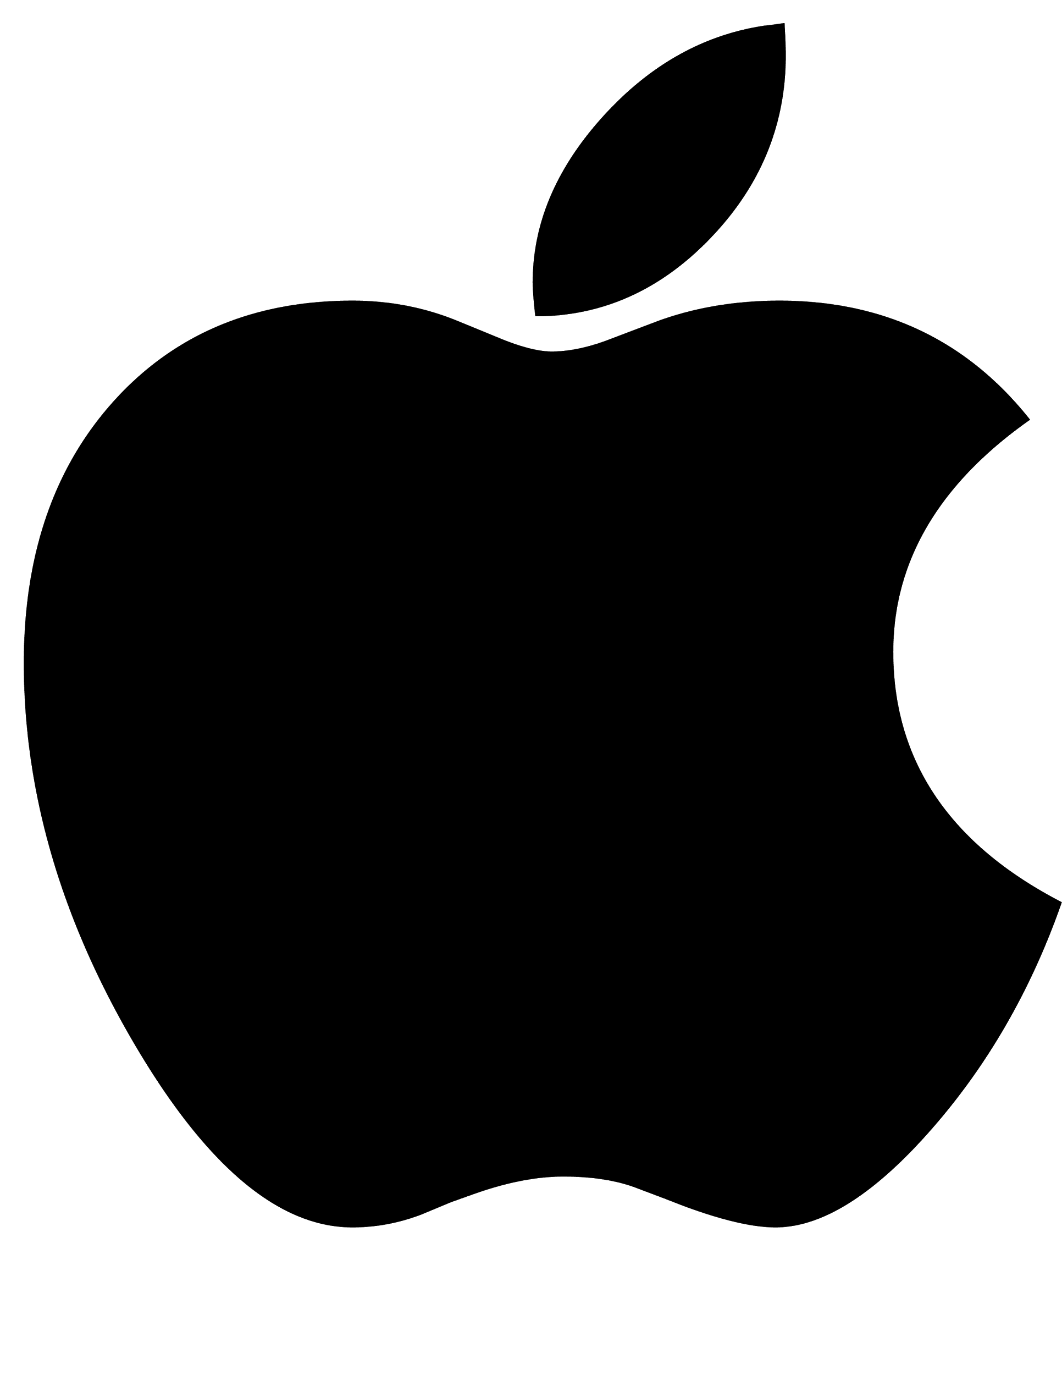
Who (What) is Apple?
Producer of popular personal devices such as the Mac, iPad, and iPhone.
Accounts for 0.5% of the United States GDP(!!!)
Sold roughly 75 million iPhones in the last financial Quarter alone.

Slide 3
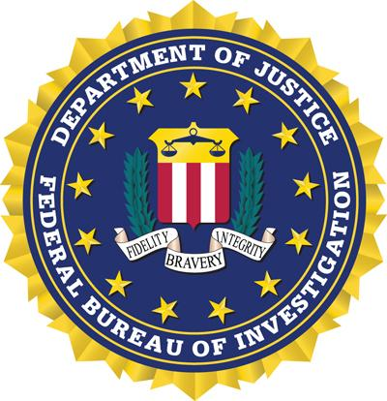
Who (What) is the FBI
Federal Bureau of Investigation
“Domestic intelligence and security service of the United States”
Reports to the Attorney General and Director of National Intelligence.
Known for work in counterintelligence and counterterrorism for the United States.

Slide 4
So… Why are these two entities in the news a lot recently?

Slide 5
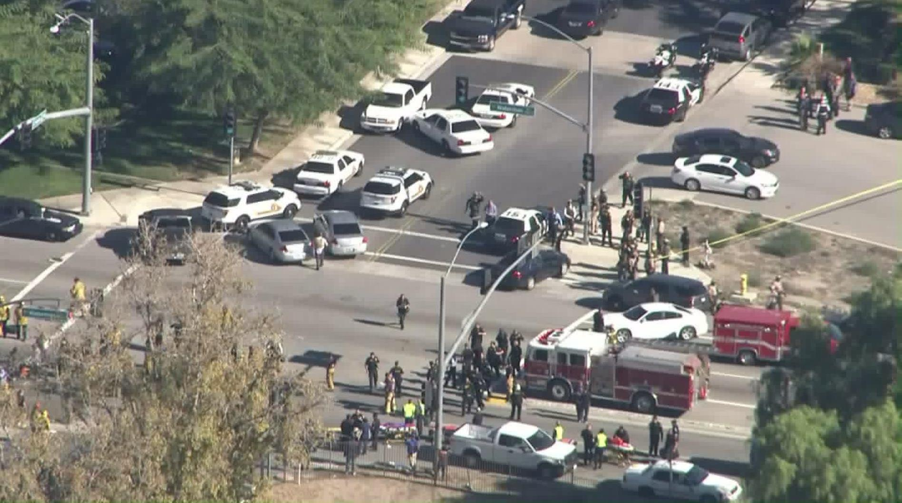
San Bernardino Shooting
The Relevant Information
Tragic shooting that occurred in San Bernardino County on December 2nd, 2015.
Carried out by two individuals with potential ISIS/ISIL connections
While the city police and FBI were able to gather a tremendous amount of information from the crime scenes, there was a locked iPhone that belonged to one of the killers found at one of the scenes.
This iPhone could contain a lot of information about calls made during the hours of the event, texts received and sent, and could potentially confirm whether or not this attack was linked to ISIS/ISIL

Slide 6
So How Does Apple Come Into the Equation?
Watch This Video

Slide 7
What do you think the benefits are in forcing Apple to create the firmware that would break their security?

Slide 8
What do you think the potential problems in forcing Apple to create the firmware that would break their security?

Slide 9
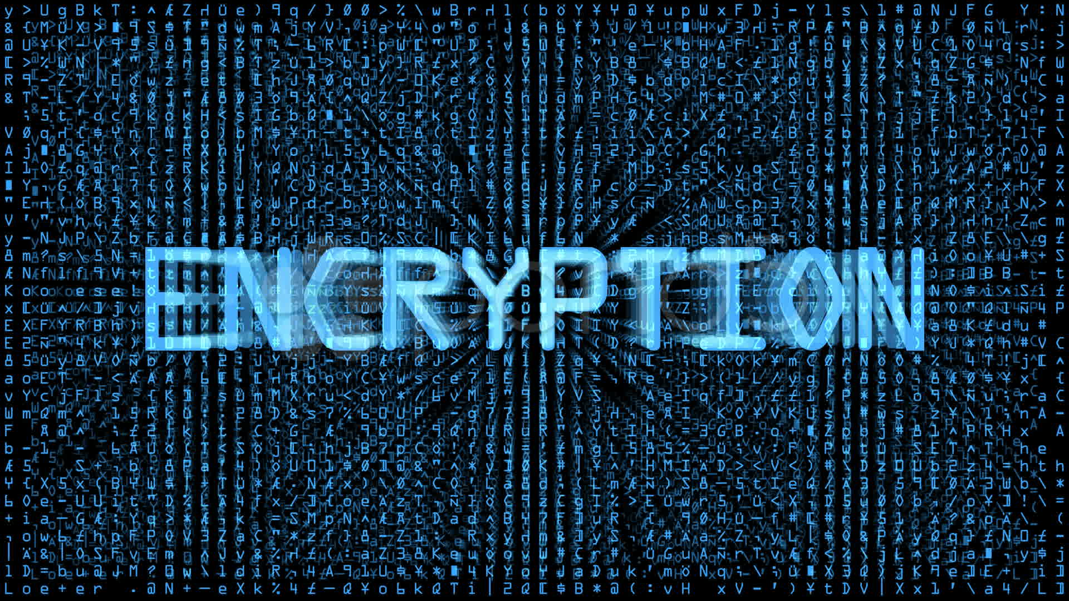
So… What’s the Big Deal? Can’t Apple just make the firmware and then destroy it?
Koan 6: Nothing Goes Away (Blown to Bits Chapter 1)
There’s no such thing as destroying software (or the implementation ideas of software) permanently.
It’s about setting a potential legal precedent
Even if that specialized OS was created specifically for that one phone, who’s to say that the FBI won’t ask for further phones to be unlocked?
This is actually already a reality.
Breaks a huge principle of Encryption and Security.

Slide 10
Conclusions
This is an ongoing case and will probably end up in a Supreme Court case
There is still a great amount of debate surrounding encryption, security, and the privacy of one’s data in relation to Constitutional Rights.
Does the “good” outweigh the “bad?” Should that matter in this case?

